Slide 1
Secure data hiding in images using steganography
CAPSTONE PROJECT
Presented By: Gopika D
Student Name : Gopika D
College Name & Department : Loyola ICAM College of Engineering and Technology / Information Technology

Slide 2
OUTLINE
Problem Statement
Technology used
Wow factor
End users
Result
Conclusion
Git-hub Link
Future scope

Slide 3
Problem Statement
Sensitive information transmitted over digital channels faces the constant threat of
interception and unauthorized access. While encryption effectively secures data, it also
makes the presence of hidden information evident, potentially attracting malicious attacks.
This visibility can increase the risk of targeted breaches,where attackers specifically
attempt to decrypt or manipulate the protected data. Hence, there is a pressing need for a
method that not only ensures confidentiality through encryption but also conceals the
existence of the hidden data itself. Such a technique would provide an added layer of
security, making it significantly harder for adversaries to detect, intercept, or compromise
sensitive information.

Slide 4
Technology used
Platform: Python IDLE
Libraries:
OpenCV: For image processing and manipulation.
NumPy: For handling and manipulating image arrays.
PIL (Pillow): For image handling and operations.
Cryptography: For encrypting and securing the hidden messages.

Slide 5
Wow factors
Layered Security: Merges encryption with concealed messages for enhanced protection.
Historical Significance: Steganography has been used since ancient times, including in wartime espionage.
Modern Uses: Applied in digital forensics, copyright protection, and various other fields.
Hidden in Plain Sight: Messages can be embedded in images without noticeable alterations.
Power of Open Source: Tools like OpenCV make image processing both accessible and efficient.

Slide 6
End users
Individuals: Maintaining privacy in personal communications.
Journalists & Whistleblowers: Securely sharing sensitive information.
Corporations: Safeguarding confidential data and intellectual property.
Government Agencies: Ensuring secure communication and protecting national interests.
Digital Forensics Experts: Investigating cybercrimes and preserving digital evidence.

Slide 7
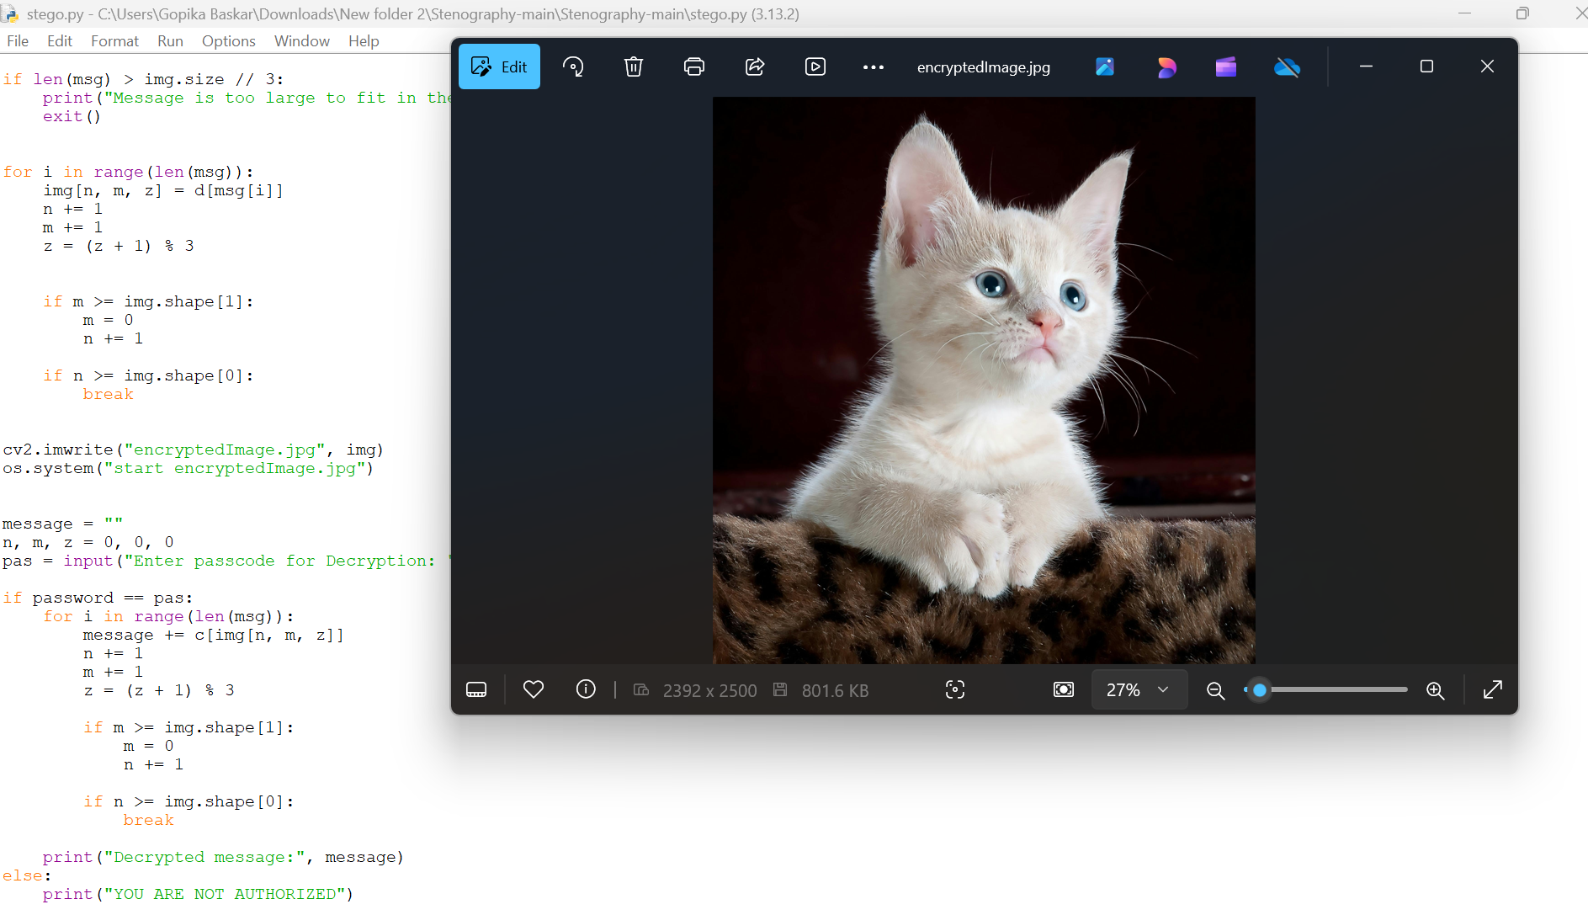
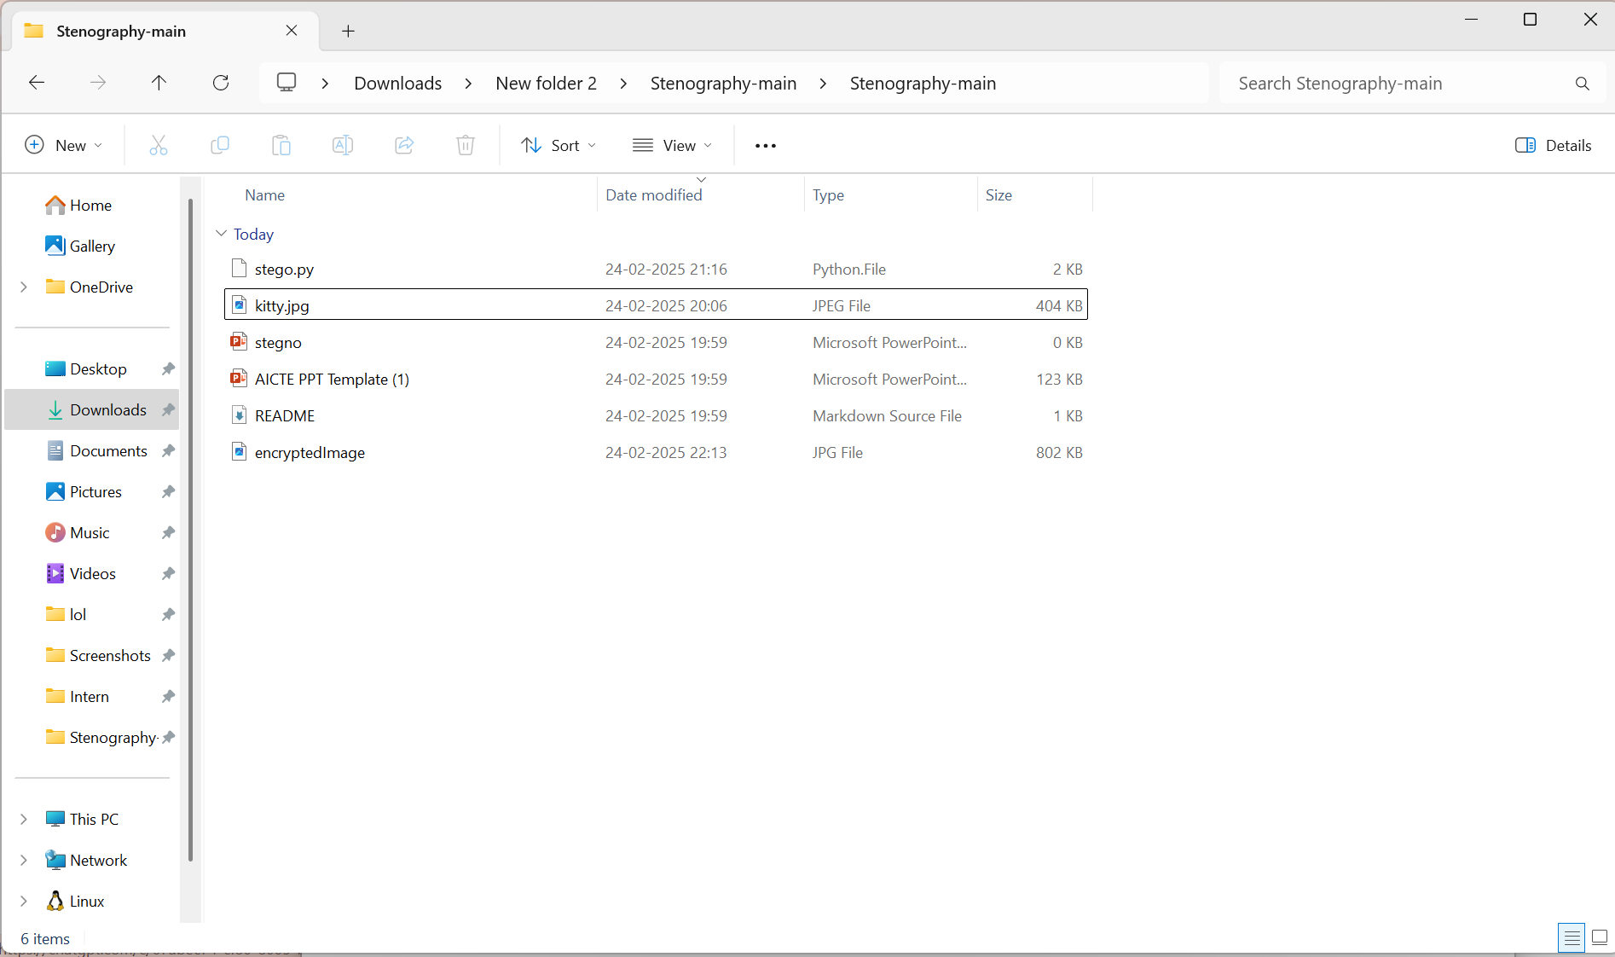
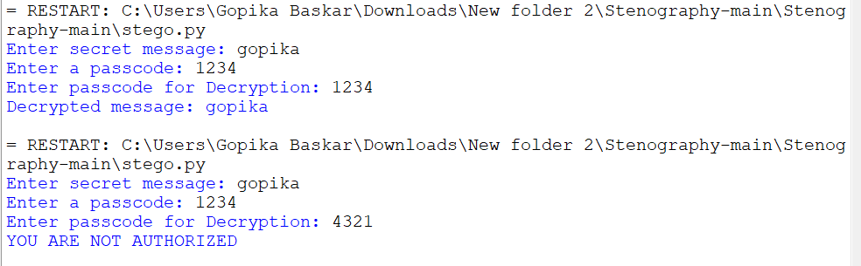
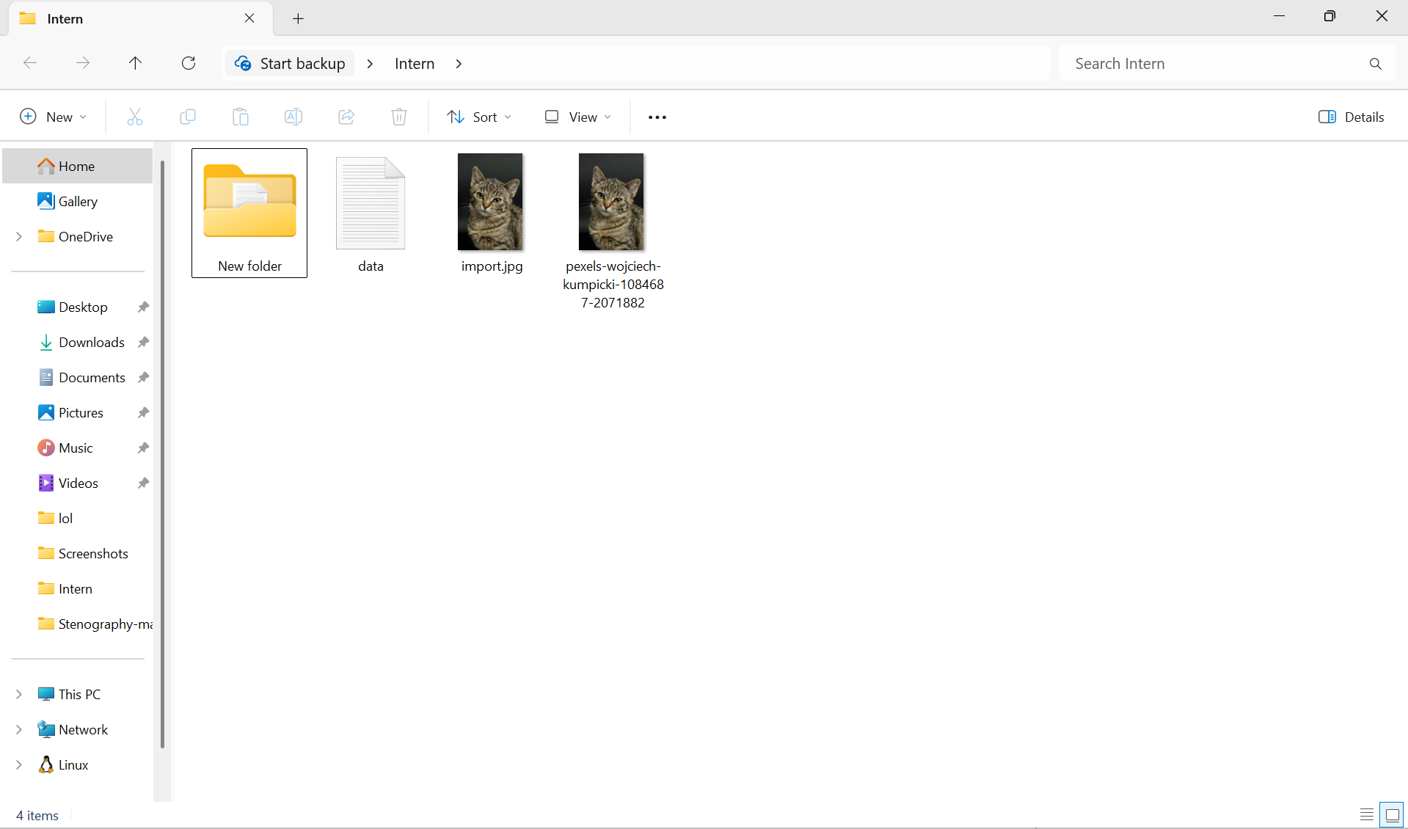
Results

Slide 8
Conclusion
This project explores the powerful application of steganography for securely embedding and retrieving hidden messages within digital images. By leveraging Python and advanced image-processing libraries such as OpenCV, NumPy, and PIL, we ensure that confidential information can be seamlessly concealed without altering the visual integrity of the image.
The implementation of this technique allows for covert communication, ensuring that sensitive data can be transmitted securely while remaining undetectable to unintended recipients. This approach significantly enhances data privacy and security, making it an invaluable tool in various domains, including personal privacy protection, corporate data security, and governmental intelligence operations.
Moreover, by integrating encryption with steganography, this method further strengthens the confidentiality and resilience of digital communication, providing a robust defense against cyber threats and unauthorized access.

Slide 9
GitHub Link
https://github.com/Gopika2606/Steganography.git

Slide 10
Future scope(optional)
Advanced Cybersecurity – AI-driven anti-detection methods and blockchain integration for tamper-proof
security.
AI-Powered Steganography – Deep learning-based techniques for undetectable data hiding and real-time
encoding.
Defense & Intelligence – Covert communication for military operations and espionage.
Digital Watermarking – Secure copyright protection and tamper detection in media and documents.
Cloud & IoT Security – Secure cloud storage and hidden data transmission in smart devices.
Quantum Steganography – Quantum-resistant techniques for unbreakable encryption and secure key
distribution.

Slide 11
THANK YOU

